Slide 1
Week 08, pt 2: Electric Boogaloo
Ch 9 How to work with functions

Slide 2
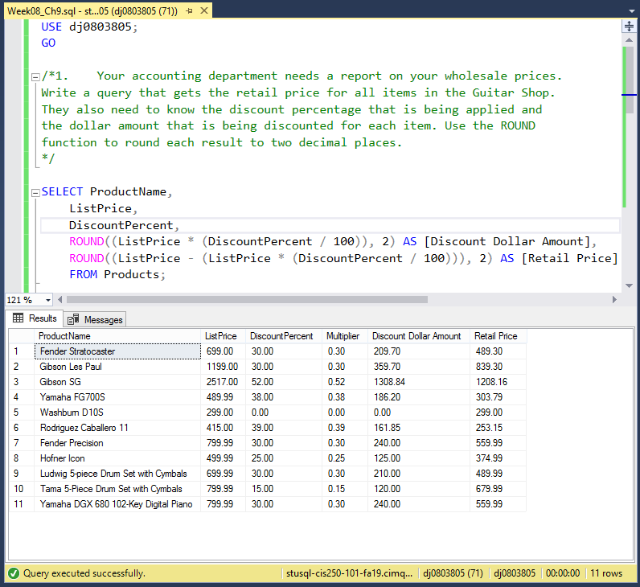
Question 1
This query demonstrates the ROUND function via rounding percentages. An interesting quirk of the ROUND function that was discovered is that it doesn’t truncate trailing zeros, if they’re present. It was simply worked around in this case, but presumably one would use a different function to trim them off if necessary.
Source:
https://www.w3schools.com/sql/func_sqlserver_round.asp

Slide 3
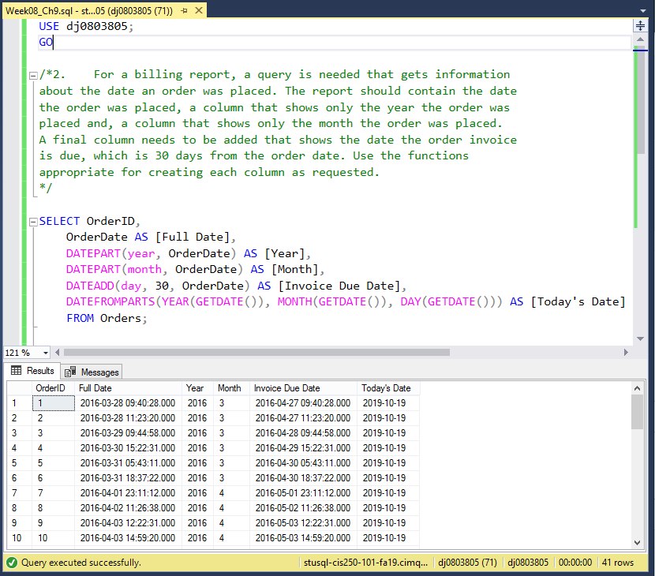
Question 2
This query demonstrates several date related functions, separating out separate parts with DATEPART() as well as establishing a thirty-day difference with DATEADD().
The final column [Today’s Date] is intended to show an alternative function to DATEADD() – YEAR() for getting the year, MONTH() for getting the month, and DAY() for getting the day. (These aren’t included in the link list for brevity’s sake.) It also, conveniently, demonstrates GETDATE() (Which, shockingly, returns today’s date.)
Links:
https://www.w3schools.com/sql/func_sqlserver_datepart.asp
https://www.w3schools.com/sql/func_sqlserver_dateadd.asp
https://www.w3schools.com/sql/func_sqlserver_datefromparts.asp
https://www.w3schools.com/sql/func_sqlserver_getdate.asp

Slide 4
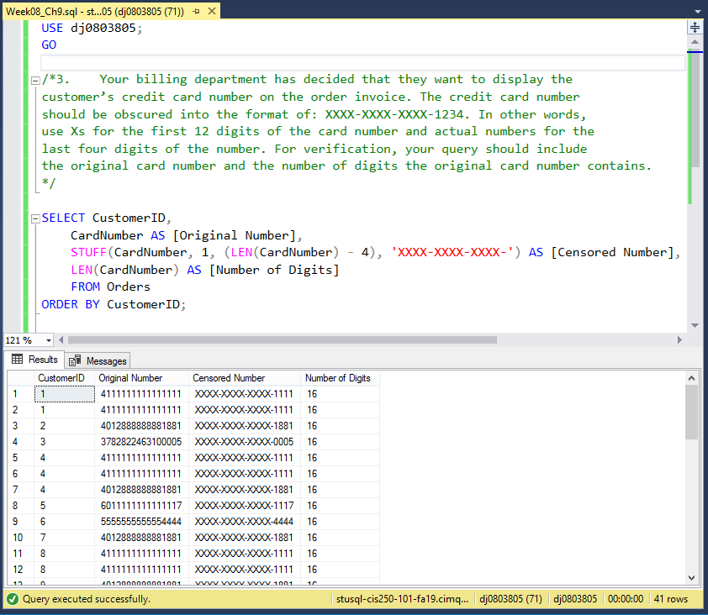
Question 3
This query uses two functions: LEN() to get the length of the string, and STUFF to replace all but the last four digits (LEN – 4) of that string with the letter “X”.
Links:
https://www.w3schools.com/sql/func_sqlserver_len.asp
https://www.w3schools.com/sql/func_sqlserver_stuff.asp

Slide 5
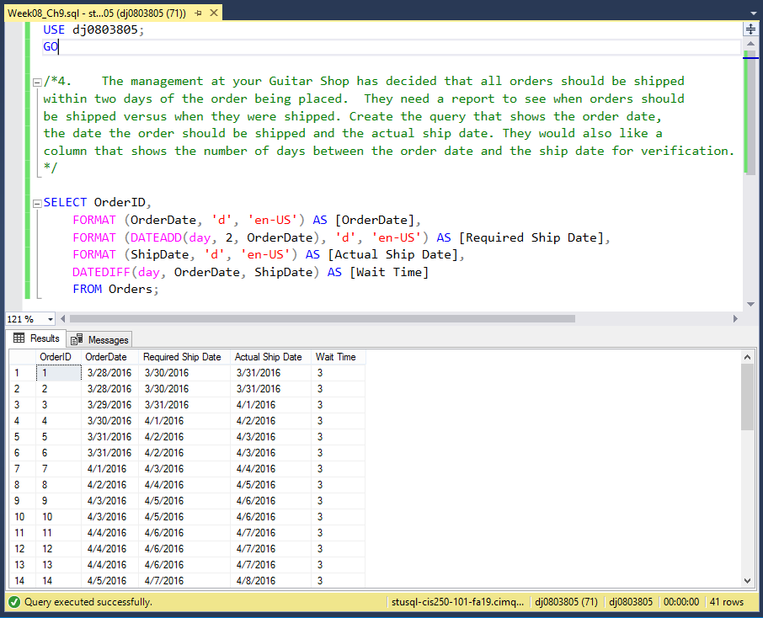
Question 4
This query sees the return of DATEADD() to get the “proper” shipping date, and then DATEDIFF() to get the number of days it took to actually ship it. This company appears to be in the habit of shipping in exactly three days, rather than two – naughty! (Some additional FORMAT()-ing was used to make this one easier to read, as well.)
Links:
https://www.w3schools.com/sql/func_sqlserver_dateadd.asp
https://www.w3schools.com/sql/func_sqlserver_datediff.asp

